Slide 1
Maps of Meaning (by Jordan B. Peterson)

Slide 2
‘A Place of Things’ And ‘a Forum for Action’
The world can be validly construed as a forum for action, as well as a place of things.
We describe the world as a place of things, using the formal methods of science. The techniques of narrative, however—myth, literature and drama—portray the world as a forum for action.
The two forms of representation have been unnecessarily set at odds, because we have not yet formed a clear picture of their respective domains.
The domain of the former view (A place of things) is the objective world—what is, from the perspective of intersubjective perception.
The domain of the latter view (a forum for action) is the world of value—what is and what should be, from the perspective of emotion and action.

Slide 3
A Forum For Action
The world as forum for action is composed, essentially, of three constituent elements, which tend to manifest themselves in typical patterns of metaphoric representation.
First is unexplored territory—the Great Mother, nature, creative and destructive, source and final resting place of all determinate things.
Second is explored territory—the Great Father, culture, protective and tyrannical, cumulative ancestral wisdom.
Third is the process that mediates between unexplored and explored territory—the Divine Son, the archetypal individual, the creative, the exploratory, and the vengeful adversary.

Slide 4
The Unknown, The Known and The Explorer
We are adapted to this world of divine characters, much as to the objective world.
The fact of this adaptation implies that the environment is in “reality” a forum for action, as well as a place of things.
Unprotected exposure to unexplored territory produces fear.
The individual is protected from such fear as a consequence of ritual imitation of the Great Father—as a consequence of the adoption of group identity, which restricts the meaning of things, and confers predictability on social interactions.
When identification with the group is made absolute, however—when everything has to be controlled, when the unknown is no longer allowed to exist—the creative exploratory process that updates the group can no longer manifest itself. This restriction of adaptive capacity dramatically increases the probability of social aggression.
Rejection of the unknown is tantamount to “identification with the devil,” the mythological counterpart and eternal adversary of the world-creating exploratory hero. Such rejection and identification is a consequence of Luciferian pride, which states: all that I know is all that is necessary to know. This pride is totalitarian assumption of omniscience—is adoption of God’s place by “reason”—is something that inevitably generates a state of personal and social being indistinguishable from hell. This hell develops because creative exploration—impossible, without (humble) acknowledgment of the unknown—constitutes the process that constructs and maintains the protective adaptive structure that gives life much of its acceptable meaning.

Slide 5
Role of Personal Interest in Maintenance of The Group
“Identification with the devil” amplifies the dangers inherent in group identification, which tends of its own accord towards pathological stultification. Loyalty to personal interest-subjective meaning—can serve as an antidote to the overwhelming temptation constantly posed by the possibility of denying anomaly.
Personal interest—subjective meaning—reveals itself at the juncture of explored and unexplored territory, and is indicative of participation in the process that ensures continued healthy individual and societal adaptation.
Loyalty to personal interest is equivalent to identification with the archetypal hero—the “savior”—who upholds his association with the creative Word in the face of death, and despite group pressure to conform. Identification with the hero serves to decrease the unbearable motivational valence of the unknown; furthermore, provides the individual with a standpoint that simultaneously transcends and maintains the group.

Slide 6
Chapter 1: Maps of Experience

Slide 7
Object and Meaning
The world can be validly construed as forum for action, or as place of things.
The former manner of interpretation-more primordial, and less clearly understood-finds its expression in the arts or humanities, in ritual, drama, literature and mythology.
The world as forum for action is a place of value, a place where all things have meaning.
This meaning, which is shaped as a consequence of social interaction, is implication for action, or - at a higher level of analysis - implication for the configuration of the interpretive schema that produces or guides action.

Slide 8
A Place of Things
The latter manner of interpretation - the world as place of things - finds its formal expression in the methods and theories of science.
Science allows for increasingly precise determination of the consensually validatable properties of things, and for efficient utilization of precisely determined things as tools (once the direction such use is to take has been determined, through application of more fundamental narrative processes).
No complete world-picture can be generated without use of both modes (a forum for action and a place of things) of construal.
The fact that one mode is generally set at odds with the other means only that the nature of their respective domains remains insufficiently discriminated. Adherents of the mythological worldview tend to regard the statements of their creeds as indistinguishable from empirical “fact,” even though such statements were generally formulated long before the notion of objective reality emerged. Those who, by contrast, accept the scientific perspective—who assume that it is, or might become, complete-forget that an impassable gulf currently divides what is from what should be.

Slide 9
Four things we need to know
We need to know four things:
what there is,
what to do about what there is,
that there is a difference between knowing what there is, and
knowing what to do about what there is and what that difference is.

Slide 10
What there is
To explore something, to “discover what it is”—that means most importantly to discover its significance for motor output, within a particular social context, and only more particularly to determine its precise objective sensory or material nature. This is knowledge in the most basic of senses—and often constitutes sufficient knowledge.

Slide 11
What to do about what there is
Imagine that a baby girl, toddling around in the course of her initial tentative investigations, reaches up onto a countertop to touch a fragile and expensive glass sculpture. She observes its color, sees its shine, feels that it is smooth and cold and heavy to the touch. Suddenly her mother interferes, grasps her hand, tells her not to ever touch that object. The child has just learned a number of specifically consequential things about the sculpture—has identified its sensory properties, certainly. More importantly, however, she has determined that approached in the wrong manner, the sculpture is dangerous (at least in the presence of mother); has discovered as well that the sculpture is regarded more highly, in its present unaltered configuration, than the exploratory tendency—at least (once again) by mother. The baby girl has simultaneously encountered an object, from the empirical perspective, and its socioculturally determined status. The empirical object might be regarded as those sensory properties “intrinsic” to the object. The status of the object, by contrast, consists of its meaning—consists of its implication for behavior. Everything a child encounters has this dual nature, experienced by the child as part of a unified totality. Everything is something, and means something—and the distinction between essence and significance is not necessarily drawn.

Slide 12
Analysis of mythology
Proper analysis of mythology is not mere discussion of “historical” events enacted upon the world stage (as the traditionally religious might have it), and it is not mere investigation of primitive belief (as the traditionally scientific might presume). It is, instead, the examination, analysis and subsequent incorporation of an edifice of meaning, which contains within it hierarchical organization of experiential valence. The mythic imagination is concerned with the world in the manner of the phenomenologist, who seeks to discover the nature of subjective reality, instead of concerning himself with description of the objective world. Myth, and the drama that is part of myth, provide answers in image to the following question: “how can the current state of experience be conceptualized in abstraction, with regards to its meaning?” [which means its (subjective, biologically predicated, socially constructed) emotional relevance or motivational significance].
Meaning means implication for behavioral output; logically, therefore, myth presents information relevant to the most fundamental of moral problems: “what should be? (what should be done?)” The desirable future (the object of what should be) can be conceptualized only in relationship to the present, which serves at least as a necessary point of contrast and comparison. To get somewhere in the future presupposes being somewhere in the present; furthermore, the desirability of the place traveled to depends on the valence of the place vacated.

Slide 13
The Three Questions
The question of “what should be?” (what line should be traveled?) therefore has contained within it, so to speak, three subqueries, which might be formulated as follows:
1) What is? What is the nature (meaning, the significance) of the current state of experience?
2) What should be? To what (desirable, valuable) end should that state be moving?
3) How should we therefore act? What is the nature of the specific processes by which the present state might be transformed into that which is desired?

Slide 14
What should be?
Active apprehension of the goal of behavior, conceptualized in relationship to the interpreted present, serves to constrain or provide determinate framework for the evaluation of ongoing events, which emerge as a consequence of current behavior. The goal is an imaginary state, consisting of “a place” of desirable motivation or affect—a state that only exists in fantasy, as something (potentially) preferable to the present.
(Construction of the goal therefore means establishment of a theory about the ideal relative status of motivational states—about the good.) This imagined future constitutes a vision of perfection, so to speak, generated in the light of all current knowledge (at least under optimal conditions), to which specific and general aspects of ongoing experience are continually compared. This vision of perfection is the promised land, mythologically speaking—conceptualized as a spiritual domain (a psychological state), a political utopia (a state, literally speaking), or both, simultaneously.

Slide 15
Mythology comes to answer the questions for us...
We answer the question “what should be?” by formulating an image of the desired future.
We cannot conceive of that future, except in relationship to the (interpreted) present— and it is our interpretation of the emotional acceptability of the present that comprises our answer to the question “what is?” [“what is the nature (meaning, the significance) of the current state of experience?”].
We answer the question “how then should we act?” by determining the most efficient and self-consistent strategy, all things considered, for bringing the preferred future into being.
Our answers to these three fundamental questions—modified and constructed in the course of our social interactions—constitutes our knowledge, insofar as it has any behavioral relevance; constitutes our knowledge, from the mythological perspective.
The structure of the mythic known—what is, what should be, and how to get from one to the other—is presented in Figure 1:

Slide 16
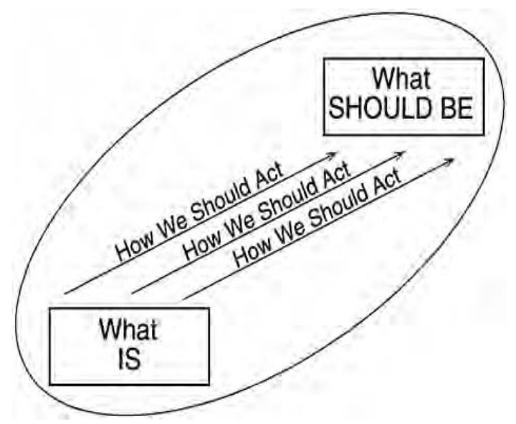

Slide 17
Chapter 2: Maps of Meaning

Slide 18
Model of reality
You work in an office; you are climbing the corporate ladder. Your daily activity reflects this superordinate goal. You are constantly immersed in one activity or another designed to produce an elevation in your status from the perspective of the corporate hierarchy.
Today, you have to attend a meeting that may prove vitally important to your future. You have an image in your head, so to speak, about the nature of that meeting and the interactions that will characterize it. You imagine what you would like to accomplish. Your image of this potential future is a fantasy, but it is based, insofar as you are honest, on all the relevant information derived from past experience that you have at your disposal. You have attended many meetings. You know what is likely to happen, during any given meeting, within reasonable bounds; you know how you will behave, and what effect your behavior will have on others. Your model of the desired future is clearly predicated on what you currently know.
You also have a model of the present, constantly operative. You understand your (somewhat subordinate) position within the corporation, which is your importance relative to others above and below you in the hierarchy. You understand the significance of those experiences that occur regularly while you are during your job: you know who you can give orders to, who you have to listen to, who is doing a good job, who can safely be ignored, and so on. You are always comparing this present (unsatisfactory) condition to that of your ideal, which is you, increasingly respected, powerful, rich and happy, free of anxiety and suffering, climbing toward your ultimate success. You are unceasingly involved in attempts to transform the present, as you currently understand it, into the future, as you hope it will be. Your actions are designed to produce your ideal— designed to transform the present into something ever more closely resembling what you want. Your are confident in your model of reality, in your story; when you put it into action, you get results.

Slide 19
A story about the unknown
Let’s talk about ‘the’ scheduled meeting you have at work.
You prepare yourself mentally for your meeting. You envision yourself playing a centrally important role—resolutely determining the direction the meeting will take, roducing a powerful impact on your co-workers. You are in your office, preparing to leave. The meeting is taking place in another building, several blocks away. You formulate provisional plans of behavior designed to get you there on time. You estimate travel time at fifteen minutes.
You leave your office on the twenty-seventh floor, and you wait by the elevator. The minutes tick by—more and more of them. The elevator fails to appear. You had not taken this possibility into account. The longer you wait, the more nervous you get. Your heart
rate starts increasing, as you prepare for action (action unspecified, as of yet). Your palms sweat. You flush. You berate yourself for failing to consider the potential impact of such a delay. Maybe you are not as smart as you think you are. You begin to revise your model of yourself. No time for that now: you put such ideas out of your head and concentrate on the task at hand.
The unexpected has just become manifest—in the form of the missing elevator. You planned to take it to get where you were going; it did not appear. Your original plan of action is not producing the effects desired. It was, by your own definition, a bad plan. You need another one—and quickly. Luckily you have an alternate strategy at your disposal.
The stairs! You dash to the rear of the building. You try the door to the stairwell. It is locked. You curse the maintenance staff. You are frustrated and anxious. The unknown has emerged once again. You try another exit. Success! The door opens. Hope springs forth from your breast. You still might make it on time. You rush down the stairs—all twenty-seven floors—and onto the street.

Slide 20
Effects the Unknown has on you
You are, by now, desperately late. As you hurry along, you monitor your surroundings: is progress toward your goal continuing? Anyone who gets in your way inconveniences you—elderly women, playful, happy children, lovers out for a stroll. You are a good person, under most circumstances—at least in your own estimation. Why, then, do these innocent people aggravate you so thoroughly? You near a busy intersection. The crosswalk light is off. You fume and mutter away stupidly on the sidewalk. Your blood pressure rises. The light finally changes. You smile and dash forward. Up a slight rise you run. You are not in great physical shape. Where did all this energy come from? You are approaching the target building. You glance at your watch.
Five minutes left: no problem. A feeling of relief and satisfaction floods you. You are there; in consequence, you are not an idiot. If you believed in God, you would thank Him.
Had you been early—had you planned appropriately—the other pedestrians and assorted obstacles would not have affected you at all. You might have even appreciated them—at least the good-looking ones—or may at least not have classified them as obstacles.
Maybe you would have even used the time to enjoy your surroundings (unlikely) or to think about other issues of real importance—like tomorrow’s meeting.
You continue on your path. Suddenly, you hear a series of loud noises behind you— noises reminiscent of a large motorized vehicle hurtling over a small concrete barrier (much like a curb). You are safe on the sidewalk—or so you presumed a second ago. Your meeting fantasies vanish. The fact that you are late no longer seems relevant. You stop hurrying along, instantly, arrested in your path by the emergence of this new phenomenon. Your auditory system localizes the sounds in three dimensions. You involuntarily orient your trunk, neck, head and eyes toward the place in space from which the sounds apparently emanate. Your pupils dilate, and your eyes widen. Your heart rate speeds up, as your body prepares to take adaptive action—once the proper path of that action has been specified.

Slide 21
You actively explore the unexpected occurrence, once you have oriented yourself toward it, with all the sensory and cognitive resources you can muster. You are generating hypotheses about the potential cause of the noise even before you turn. Has a van jumped the curb? The image flashes through your mind. Has something heavy fallen from a building? Has the wind overturned a billboard or street sign? Your eyes actively scan the relevant area. You see a truck loaded with bridge parts heading down the street, just past a pothole in the road. The mystery is solved. You have determined the specific motivational significance of what just seconds ago was the dangerous and threatening unknown, and it is zero. A loaded truck hit a bump. Big deal! Your heart slows down. Thoughts of the impending meeting re-enter the theater of your mind. Your original journey continues as if nothing has happened.
What is going on? Why are you frightened and frustrated by the absence of the expected elevator, the presence of the old woman with the cane, the carefree lovers, the loud machinery? Why are you so emotionally and behaviorally variable?

Slide 22
Another Story About The Unknown
Let us presume that you return from your meeting. You made it on time and, as far as you could tell, everything proceeded according to plan.
You noticed that your colleagues appeared a little irritated and confused by your behavior as you attempted to control the situation, but you put this down to jealousy on their part—to their inability to comprehend the majesty of your conceptualizations. You are satisfied, in consequence—satisfied temporarily—so you start thinking about tomorrow, as you walk back to work. You return to your office. There is a message on your answering machine. The boss wants to see you. You did not expect this. Your heart rate speeds up a little: good or bad, this news demands preparation for action.
What does she want? Fantasies of potential future spring up. Maybe she heard about your behavior at the meeting and wants to congratulate you on your excellent work. You walk to her office, apprehensive but hopeful.
You knock and stroll in jauntily. The boss looks at you and glances away somewhat unhappily. Your sense of apprehension increases. She motions for you to sit, so you do. What is going on? She says, “I have some bad news for you.” This is not good. This is not what you wanted. Your heart rate is rising unpleasantly. You focus all of your attention on your boss. “Look,” she says, “I have received a number of very unfavorable reports regarding your behavior at meetings. All of your colleagues seem to regard you as a rigid and overbearing negotiator. Furthermore, it has become increasingly evident that you are unable to respond positively to feedback about your shortcomings. Finally, you do not appear to properly understand the purpose of your job or the function of this corporation.”

Slide 23
First Encounter With ‘The Revolutionary’ Situation
You are shocked beyond belief, paralyzed into immobility. Your vision of the future with this company vanishes, replaced by apprehensions of unemployment, social disgrace and failure. You find it difficult to breathe. You flush and perspire profusely; your face is a mask of barely suppressed horror. You cannot believe that your boss is such a bitch.
“You have been with us for five years,” she continues, “and it is obvious that your performance is not likely to improve. You are definitely not suited for this sort of career, and you are interfering with the progress of the many competent others around you. In consequence, we have decided to terminate your contract with us, effective immediately. If I were you, I would take a good look at myself.”
You have just received unexpected information, but of a different order of magnitude than the petty anomalies, irritations, threats and frustrations that disturbed your equilibrium in the morning. You have just been presented with incontrovertible evidence that your characterizations of the present and of the ideal future are seriously, perhaps irreparably, flawed. Your presumptions about the nature of the world are in error. The world you know has just crumbled around you. Nothing is what it seemed; everything is unexpected and new again. You leave the office in shock. In the hallway, other employees avert their gaze from you, in embarrassment. Why did you not see this coming? How could you have been so mistaken in your judgment?
Maybe everyone is out to get you.
Better not think that.

Slide 24
Need for re-evaluation of the present
You stumble home, in a daze, and collapse on the couch. You can’t move. You are hurt and terrified. You feel like you might go insane. Now what? How will you face people? The comfortable, predictable, rewarding present has vanished. The future has opened up in front of you like a pit, and you have fallen in. For the next month, you find yourself unable to act. Your spirit has been extinguished. You sleep and wake at odd hours; your appetite is disturbed. You are anxious, hopeless and aggressive, at unpredictable intervals. You snap at your family and torture yourself. Suicidal thoughts
enter the theater of your imagination. You do not know what to think or what to do: you are the victim of an internal war of emotion.
Your encounter with the terrible unknown has shaken the foundations of your worldview. You have been exposed, involuntarily, to the unexpected and revolutionary.
Chaos has eaten your soul. This means that your long-term goals have to be reconstructed, and the motivational significance of events in your current environment re-evaluated—literally revalued.

Slide 25
This capacity for complete revaluation, in the light of new information, is even more particularly human than the aforementioned capability for exploration of the unknown and generation of new information. Sometimes, in the course of our actions, we elicit phenomena whose very existence is impossible, according to our standard methods of construal (which are at base a mode of attributing motivational significance to events). Exploration of these new phenomena, and integration of our findings into our knowledge, occasionally means reconceptualization of that knowledge (and consequent re-exposure to the unknown, no longer inhibited by our mode of classification). This means that simple movement from present to future is occasionally interrupted by a complete breakdown and reformulation, a reconstitution of what the present is and what the future should be. The ascent of the individual, so to speak, is punctuated by periods of dissolution and rebirth. The more general model of human adaptation—conceptualized most simply as steady state, breach, crisis, redress—therefore ends up looking like Figure 4: Revolutionary Adaptation.

Slide 26
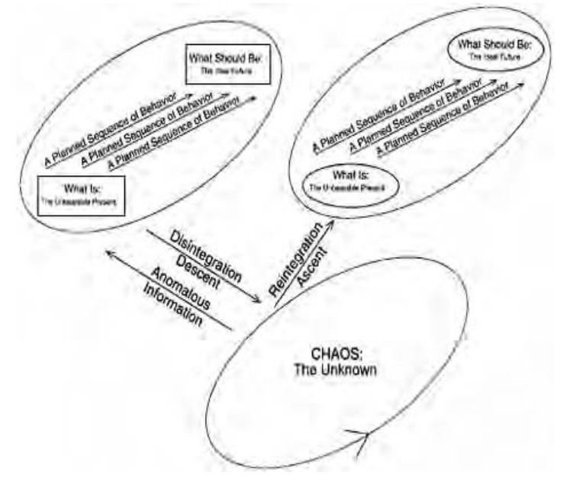

Slide 27
A man reborn
A month after you were fired, a new idea finds its way into your head. Although you never let yourself admit it, you didn’t really like your job. You only took it because you felt that it was expected of you. You never put your full effort into it, because you really wanted to do something else—something other people thought was risky or foolish. You made a bad decision, a long time ago. Maybe you needed this blow, to put you back on the path. You start imagining a new future—one where you are not so “secure,” maybe, but where you are doing what you actually want to do. The possibility of undisturbed sleep returns, and you start eating properly again. You are quieter, less arrogant, more accepting—except in your weaker moments. Others make remarks, some admiring, some envious, about the change they perceive in you. You are a man recovering from a long illness—a man reborn.
Indeed, our very cultures are erected upon the foundation of a single great story:
Paradise, encounter with chaos, fall and redemption.

Slide 28
The Valence of Things
The existential psychotherapist Viktor Frankl tells a story from his experiences as a Nazi death camp inmate that makes this point most strikingly:
Take as an example something that happened on our journey from Auschwitz to the camp affiliated with Dachau. We became more and more tense as we approached a certain bridge over the Danube which the train would have to cross to reach Mauthausen, according to the statement of experienced traveling companions. Those who have never seen anything similar cannot possibly imagine the dance of joy performed in the carriage by the prisoners when they saw that our transport was not crossing the bridge and was instead heading “only” for Dachau.
And again, what happened on our arrival in that camp, after a journey lasting two days and three nights? There had not been enough room for everybody to crouch on the floor of the carriage at the same time. The majority of us had to stand all the way, while a few took turns at squatting on the scanty straw which was soaked with human urine.

Slide 29
No chimney in this camp...
When we arrived the first important news that we heard from older prisoners was that this comparatively small camp (its population was 2,500) had no “oven,” no crematorium, no gas! That meant that a person who had become a “Moslem” [no longer fit for work] could not be taken straight to the gas chamber, but would have to wait until a so-called “sick convoy” had been arranged to return to Auschwitz. This joyful surprise put us all in a good mood. The wish of the senior warden of our hut in Auschwitz had come true: we had come, as quickly as possible, to a camp which did not have a “chimney”—unlike Auschwitz. We laughed and cracked jokes in spite of, and during, all we had to go through in the next few hours.
When we new arrivals were counted, one of us was missing. So we had to wait outside in the rain and cold wind until the missing man was found. He was at last discovered in a hut, where he had fallen asleep from exhaustion. Then the roll call was turned into a punishment parade. All through the night and late into the next morning, we had to stand outside, frozen and soaked to the skin after the strain of our long journey. And yet we were all very pleased! There was no chimney in this camp and Auschwitz was a long way off.

Slide 30
Nature of Valence
Valence can be positive or negative, as the early behaviorists noted. Positive and negative are not opposite ends of a continuum, however—not in any straightforward way. The two “states” appear orthogonal, although (perhaps) mutually inhibitory.
Furthermore, positive and negative are not simple: each can be subdivided, in a more or less satisfactory manner, at least once.

Slide 31
Positively Valued Things
Positively valued things, for example, can be satisfying or promising (can serve as consummatory or incentive rewards, respectively).
Many satisfying things are consumable, in the literal sense, as outlined previously. Food, for example, is a consummatory reward to the hungry—which means that it is valued under such circumstances as a satisfaction. Likewise, water satisfies the individual deprived of liquid. Sexual contact is rewarding to the lustful, and warmth is desirable to those without shelter. Sometimes more complex stimuli are satisfying or rewarding as well. It all depends on what is presently desired, and how that desire plays itself out. A mild verbal reprimand might well foster feelings of relief in the individual who expects a severe physical beating—which is to say, technically, that the absence of an expected punishment can serve quite effectively as a reward (it is in fact the form of reward that the tyrant prefers). Regardless of their form, attained satisfactions produce satiation, calm and somnolent pleasure, and (temporary) cessation of the behaviors directed to that particular end—although behaviors that culminate in a satisfactory conclusion are more likely to be manifested, in the future, when “instinctive” or “voluntary” desire re-emerges.

Slide 32
Promises
Promises, which are also positive, might be regarded as more abstractly meaningful than satisfactions, as they indicate potential rather than actuality. Promises—cues of consummatory rewards or satisfactions—indicate the imminent attainment of something desired or potentially desirable. Their more abstract quality does not make them secondary or necessarily learned, however, as was once thought; our response to
potential satisfaction is often as basic or primary as our response to satisfaction itself. Promises (cues of satisfaction) have been regarded, technically, as incentive rewards, because they induce forward locomotion— which is merely movement toward the place that the cue indicates satisfaction will occur.
Curiosity, hope and excited pleasure tend to accompany exposure to cues of reward (and are associated with subsequent forward locomotion). Behaviors that produce promises—like those that result in satisfactions—also increase in frequency, over time.

Slide 33
Negatively valued things
Negatively valued things—which have a structure that mirrors that of their positive counterparts—can either be punishing or threatening. Punishments—a diverse group of stimuli or contexts, as defined immediately below—all appear to share one feature (at least from the perspective of the theory outlined in this manuscript): they indicate the temporary or final impossibility of implementing one or more means or attaining one or more ends. Some stimuli are almost universally experienced as punishing, because their appearance indicates reduced likelihood of carrying through virtually any imaginable plan—of obtaining almost every satisfaction, or potential desirable future. Most things or situations that produce bodily injury fall into this category. More generally, punishments might be conceived of as involuntary states of deprivation (of food, water, optimal temperature, or social contact); as disappointments or frustrations (which are absences of expected rewards), and as stimuli sufficiently intense to produce damage to the systems encountering them. Punishments stop action, or induce retreat or escape (backward locomotion), and engender the emotional state commonly known as pain or hurt. Behaviors, which culminate in punishment and subsequent hurt, tend to
extinguish—to decrease in frequency, over time.

Slide 34
Threats
Threats, which are also negative, indicate potential, like promises—but potential for punishment, for hurt, for pain. Threats—cues of punishment—are stimuli that indicate enhanced likelihood of punishment and hurt. Threats are abstract, like promises; however, like promises, they are not necessarily secondary or learned. Unexpected phenomena, for example—which constitute innately recognizable threats—stop us in our tracks, and make us feel anxiety. So, arguably, do certain innate fear stimuli—like snakes. Behaviors that culminate in the production of cues of punishment—that create situations characterized by anxiety—tend to decrease in frequency over time (much like those that produce immediate punishment).
Satisfactions and their cues are good, simply put; punishments and threats are bad. We tend to move forward (to feel hope, curiosity, joy) and then to consume (to make love, to eat, to drink) in the presence of good things; and to pause (and feel anxious), then withdraw, move backwards (and feel pain, disappointment, frustration, loneliness) when faced by things we do not like. In the most basic of situations—when we know what we are doing, when we are engaged with the familiar—these fundamental tendencies suffice.

Slide 35
Unexplored Territory
Unexpected or unpredictable things—novel things, more exactly (the class of novel things, most particularly)—have a potentially infinite, unbounded range of significance.
What does something that might be anything mean? In the extremes, it means, the worst that could be (or, at least, the worst you can imagine) and, conversely, the best that could be (or the best you can conceive of). Something new might present the possibility for unbearable suffering, followed by meaningless death—a threat virtually unbounded in significance. That new and apparently minor but nonetheless strange and worrisome ache you noticed this morning, for example, while you were exercising, might just signify the onset of the cancer that will slowly and painfully kill you. Alternatively, something unexpected might signify inconceivable opportunity for expansion of general competence and well-being. Your old, boring but secure job unexpectedly disappears. A year later, you are doing what you really want to do, and your life is incomparably better.
An unexpected thing or situation appearing in the course of goal-directed behavior constitutes a stimulus that is intrinsically problematic: novel occurrences are, simultaneously, cues for punishment (threats) and cues for satisfaction (promises).

Slide 36
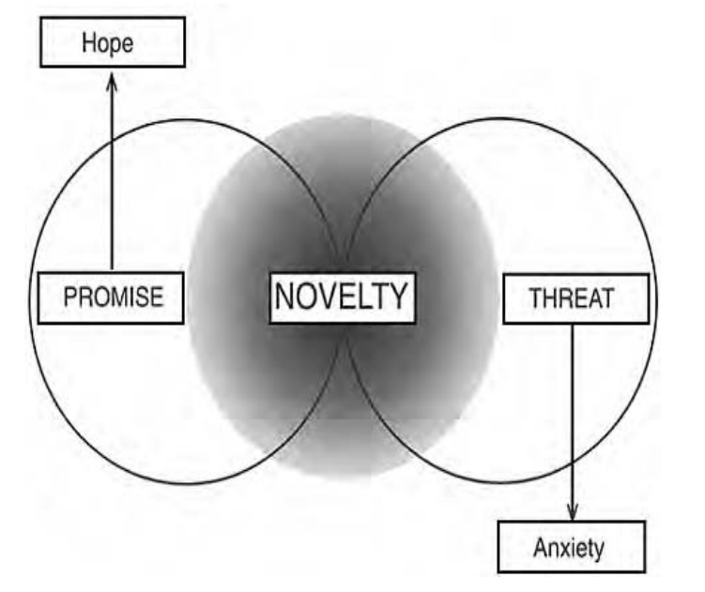

Slide 37
Normal Novelty
Something “normally” novel constitutes an occurrence which leaves the current departure point and goal intact, but indicates that the means of achieving that goal have to be modified. Let us say, for example, that you are in your office. You are accustomed to walking down an unobstructed hallway to get to the elevator. You are so used to performing this activity that you can do it “automatically”—so you often read while walking. One day, while reading, you stumble over a chair someone left in the middle of the hallway. This is normal novelty. You don’t have to alter your current goal, except in a temporary and trivial manner; you are not likely to get too upset by the unexpected obstacle. Getting to the elevator is still a real possibility, even within the desired time frame; all you have to do is walk around the chair (or move it somewhere else, if you are feeling particularly altruistic).

Slide 38
Revolutionary novelty
Revolutionary novelty is something altogether different.
Here is an example: I am sitting alone in my office, in a high-rise building, alone at night. I suddenly fantasize: “I am going to take the elevator down three floors and get something to eat” (more accurately, hunger suddenly grips my imagination, and uses it for its own purposes). This fantasy constitutes a spatially and temporally bounded image of the ideal future—an “actual” possible future, carved out as a discriminable (and thus usable) object, from the infinite domain of potential possible futures. I use this definite image to evaluate the events and processes that constitute the interpreted present, as it unfolds around me, as I walk toward the elevator (on my way to the cafeteria). I want to make reality match my fantasy—to subdue my motivation (to please the gods, so to speak). If the unexpected occurs—say, the elevator is not operating—the mismatch temporarily stops me. I replace my current plan with an alternative behavioral strategy, designed to obtain the same end. This means that I do not reconfigure the temporally and spatially bounded map that I am using to evaluate my circumstances—that I am using to regulate my emotions. All I have to do is change strategy.
I decide to take the stairs to the cafeteria. If the stairs are blocked by construction, I am in more serious trouble. My original fantasy—“go down to the cafeteria and eat”—was predicated on an implicit presumption: I can get downstairs. This presumption, which I wasn’t really even aware of (which might be regarded as axiomatic, for the purposes of the current operation), has been violated. The story “go downstairs to eat” retained its function only in an environment characterized by valid means of between-floor transportation.

Slide 39
Story about the revolutionary novelty
The existence of these means constituted a given—I had used the elevator or the stairs so often that their very presence took on the aspect of a justifiably ignored constant. Once I had mastered the stairs or the elevator—once I had learned their location, position and mechanisms—I could take them for granted and presume their irrelevance. Predictable phenomena (read “thoroughly explored, and therefore adapted to”) do not attract attention; they do not require “consciousness.” No new behavioral strategies or frameworks of reference must be generated, in their presence.
Anyway: the elevators are broken; the stairs are blocked. The map I was using to evaluate my environment has been invalidated: my ends are no longer tenable. In consequence, necessarily, the means to those ends (my plans to go to the cafeteria) have been rendered utterly irrelevant. I no longer know what to do. This means, in a nontrivial sense, that I no longer know where I am. I presumed I was in a place I was familiar with—indeed, many familiar things (the fact of the floor, for example) have not changed.
Nonetheless, something fundamental has been altered—and I don’t know how fundamental. I am now in a place I cannot easily leave. I am faced with a number of new problems, in addition to my unresolved hunger—at least in potential (Will I get home tonight? Do I have to get someone to “rescue” me? Who could rescue me? Who do I telephone to ask for help? What if there was a fire?). My old plan, my old “story” (“I am going downstairs to get something to eat”) has vanished, and I do not know how to evaluate my current circumstances. My emotions, previously constrained by the existence of a temporarily valid plan, re-emerge in a confused jumble. I am anxious (“what will I do? What if there was a fire?”), frustrated (“I’m certainly not going to get any more work done tonight, under these conditions!”) angry (“who could have been stupid enough to block all the exits?”), and curious (“just what the hell is going on around here, anyway?”). Something unknown has occurred and blown all my plans. An emissary of chaos, to speak metaphorically, has disrupted my emotional stability.

Slide 40
The unknown – An Environmental Constant
What is known and what unknown is always relative because what is unexpected depends entirely upon what we expect (desire)—on what we had previously planned and presumed. The unexpected constantly occurs because it is impossible, in the absence of omniscience, to formulate an entirely accurate model of what actually is happening or of what should happen; it is impossible to determine what results ongoing behavior will finally produce.
Errors in representation of the unbearable present and the ideal, desired future are inevitable, in consequence, as are errors in implementation and representation of the means by which the former can be transformed into the latter. The infinite human capacity for error means that encounter with the unknown is inevitable, in the course of human experience; means that the likelihood of such encounter is as certain, regardless of place and time of individual existence, as death and taxation. The (variable) existence of the unknown, paradoxically enough, can therefore be regarded as an environmental constant.
“The domain of the unknown surrounds us like an ocean surrounds an island. We can increase the area of the island, but we never take away much from the sea.”

Slide 41
Exploration... And Fear
Exploratory activity culminates normally in restriction, expansion, or transformation of the behavioral repertoire. In exceptional, non-normal circumstances—that is, when a major error has been committed—such activity culminates in revolution, in modification of the entire story guiding affective evaluation and behavioral programming. Such revolutionary modification means update of modeled reality, past, present and future, through incorporation of information generated during exploratory behavior. Successful exploration transforms the unknown into the expected, desired and predictable; establishes appropriate behavioral measures (and expectations of those measures) for next contact. Unsuccessful exploration, by contrast—avoidance or escape—leaves the novel object firmly entrenched in its initial, “natural,” anxiety-provoking category. This observation sets the stage for a fundamental realization: human beings do not learn to fear new objects or situations, or even really “learn” to fear something that previously appeared safe, when it manifests a dangerous property. Fear is the a priori position, the natural response to everything for which no structure of behavioral adaptation has been designed and inculcated. Fear is the innate reaction to everything that has not been rendered predictable, as a consequence of successful, creative exploratory behavior undertaken in its presence, at some time in the past. LeDoux states:

Slide 42
Mental Conditioning
It is well established that emotionally neutral stimuli can acquire the capacity to evoke striking emotional reaction following temporal pairing with an aversive event. Conditioning does not create new emotional responses but instead simply allows new stimuli to serve as triggers capable of activating existing, often hard-wired, species-specific emotional reactions. In the rat, for example, a pure tone previously paired with footshock evokes a conditioned fear reaction consisting of freezing behavior accompanied by a host of autonomic adjustments, including increases in arterial pressure and heart rate. Similar responses are expressed when laboratory rats are exposed to a cat for the first time, but following amygdala lesions such responses are no longer present, suggesting that the responses are genetically specified (since they appear when the rat sees a cat, a natural predator, for the first time) and involve the amygdala. The fact that electrical stimulation of the amygdala is capable of eliciting the similar response patterns further supports the notion that the responses are hard-wired.

Slide 43
‘Exploration’ and Education
The urbanity characterizing ourselves, the civilized, amiable, and admirable part of mankind, well brought up and not constantly in a state of fear…depends as much on our successfully avoiding disturbing stimulation as on a lowered sensitivity [to fear-producing stimuli]…. [T]he capacity for emotional breakdown may [well] be self-concealing, leading [animals and human beings] to find or create an environment in which the stimuli to excessive emotional response are at a minimum. So effective is our society in this regard that its members—especially the well-to-do and educated ones—may not even guess at some of their own potentialities.
One usually thinks of education, in the broad sense, as producing a resourceful, emotionally stable adult, without respect to the environment in which these traits are to appear.
To some extent this may be true.
But education can be seen as being also the means of establishing a protective social environment in which emotional stability is possible. Perhaps it strengthens the individual against unreasonable fears and rages, but it certainly produces a uniformity of appearance and behavior which reduces the frequency with which the individual member of the society encounters the causes of such emotion. On this view, the susceptibility to emotional disturbance may not be decreased. It may in fact be increased. The protective cocoon of uniformity, in personal appearance, manners, and social activity generally, will make small deviations from custom appear increasingly strange and thus (if the general thesis is sound) increasingly intolerable. The inevitable small deviations from custom will bulk increasingly large, and the members of the society, finding themselves tolerating trivial deviations well, will continue to think of themselves as socially adaptable.

Slide 44
Explored Territory
When we explore, we transform the indeterminate status and meaning of the unknown thing that we are exploring into something determinate—in the worst case, rendering it nonthreatening, nonpunishing; in the best, manipulating and/or categorizing it so that it is useful. Animals perform this transformation in the course of actual action, which is to say that they construct their worlds by shifting their positions and changing their actions in the face of the unknown, and by mapping the consequences of those shifts and changes in terms of their affective or motivational valence. When an animal encounters an unexpected situation, such as a new object placed in its cage, it first freezes, watching the object. If nothing terrible happens while it is immobile, it moves, slowly and at a distance, monitoring the thing for its reactions to these cautious exploratory activities. Perhaps the animal sniffs at the thing, or scratches at it—trying to determine what it might be good (or bad) for. It maps the utility and valence of the object, conceived in relationship to its ongoing activity (and, perhaps, to possible patterns of activity in the future). The animal builds its world of significances from the information generated in the course of—as a consequence of—ongoing exploratory behavior. The application of experimental search programs, drawn primarily from the reservoir of learned (imitated) and instinctual behavior, or manifested as trial and error, involves behavioral alteration (exploration, play) and subsequent transformation of sensory and affective input. When an animal actively explores something new, it changes the sensory quality and motivational significance of that aspect of its experience as a consequence of its exploratory strategy. This means that the animal exhibits a variety of behaviors in a given mysterious situation and monitors the results. It is the organized interpretation of these results and the behaviors that produce them that constitute the world, past, present and future, of the animal (in conjunction with the unknown, of course—which constantly supersedes the capacity for representation).

Slide 45

The Motor Homunculus

Slide 46
The body is specifically represented in the neocortex. This representation is often given schematic form as the homunculus, or “little man.” The homunculus was
“discovered” by Wilder Penfield, who mapped the surface of the cortices of his neurosurgical patients by stimulating them electrically, painstakingly, point after point. He did this to find out what different sections of the brain were doing, so that he could do the least damage possible when attempting to surgically treat epilepsy or cancer or other forms of brain abnormality. He would probe the surface of the brain of one of his (awake) patients with an electrode (patients undergoing neurosurgery are frequently awake, as the brain feels no pain) and monitor the results, either directly or by asking the patient what he or she experienced. Sometimes such stimulation would produce visions, sometimes elicit memories; other times, it produced movements or sensations. Penfield determined, in this manner, how the body was mapped onto the central nervous system—how it was incarnated, so to speak, in intrapsychic representation. He established, for example, that homunculi come in two forms, motor and sensory—the former associated with the primary zone of the motor unit, the latter associated with the primary zone of the sensory area of the sensory unit. The motor form—represented schematically in Figure 10: The Motor Homunculus—is of most interest to us, because our discussion centers on motor output. The motor homunculus is a very odd little “creature.” Its face (particularly mouth and tongue) and hands (particularly thumbs) are grossly disproportionate to the rest of its “body.” This is because comparatively large areas of the motor cortex are given over to control of the face and hands, which are capable of an immense number of complex and sophisticated operations. The motor homunculus is an interesting figure. It might be regarded as the body, insofar as the body has anything to do with the brain. It is useful to consider the structure of the homunculus, because it is in some profound way representative of our essential nature, as it finds expression in emotion and behavior.
The most outstanding characteristic of the motor homunculus, for example—the hand, with its opposable thumb—is the defining feature of the human being. The ability to manipulate and explore characteristics of objects large and small—restricted as a general capacity to the highest primates—sets the stage for elicitation of an increased range of their properties, for their utilization as tools (for more comprehensive transformation of their infinite potential into definable actuality). The hand, used additionally to duplicate the action and function of objects, also allows first for imitation (and pointing), and then for full-blown linguistic representation. Used for written language, the hand additionally enables long-distance (temporal and spatial) transfer of its ability to another (and for the elaboration and extension of exploration, during the process of writing, which is hand-mediated thinking). Even development of spoken language, the ultimate analytic motor skill, might reasonably be considered an abstract extension of the human ability to take things apart and reassemble them, in an original manner. Interplay between hand and brain has literally enabled the individual to change the structure of the world. Consideration of the structure and function of the brain must take this primary fact into account. A dolphin or whale has a large, complex brain—a highly developed nervous system—but it cannot shape its world. It is trapped, so to speak, in its streamlined test-tube-like form, specialized for oceanic life. It cannot directly alter the shape of its material environment in any complex manner. Its brain, therefore, is not likely prepared to perform any traditionally “creative” function (indeed, as one would suspect, lacks the sophisticated structuring characteristic of primate brains).

Slide 47
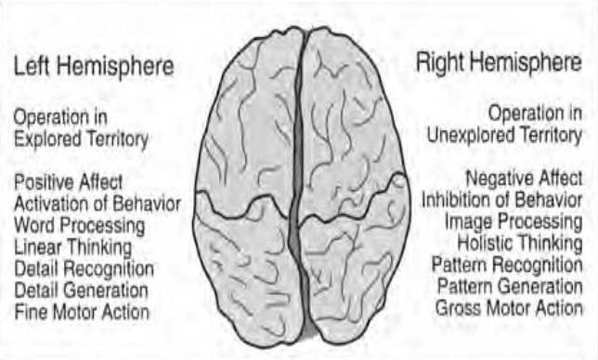
The Twin Cerebral Hemispheres and Their Functions

Slide 48
Two Types of Memory
Knowing-how information, described alternatively as procedural, habitual, dispositional, or skilled, and knowing-what information, described alternatively as declarative, episodic, factual, autobiographical, or representational, appear physiologically distinct in their material basis, and separable in course of phylo- and ontogenetic development. Procedural knowledge develops long before declarative knowledge, in evolution and individual development, and appears represented in “unconscious” form, expressible purely in performance. Declarative knowledge, by contrast—knowledge of what—simultaneously constitutes consciously accessible and communicable episodic imagination (the world in fantasy) and subsumes even more recently developed semantic (linguistically mediated) knowledge, whose operations, in large part, allow for abstract representation and communication of the contents of the imagination. Squire and Zola-Morgan have represented the relationship between these memory forms according to the schematic of Figure 12: The Multiple Structure of Memory. The neuroanatomical basis of knowing how remains relatively unspecified. Skill generation appears in part as the domain of the cortical pre/motor unit; “storage” appears to involve the cerebellum. Knowing what, by contrast, appears dependent for its existence on the intact function of the cortical sensory unit, in interplay with the hippocampal system. Much of our knowing what, however—our description of the world—is about knowing how, which is behavioral knowledge, wisdom. Much of our descriptive knowledge—representational knowledge—is representation of what constitutes wisdom (without being that wisdom, itself). We have gained our description of wisdom by watching how we act, in our culturally governed social interactions, and by representing those actions.
We know how, which means how to act to transform the mysterious and ever-threatening world of the present into what we desire, long before we know how we know how, or why we know how. This is to say, for example, that a child learns to act appropriately (assuming it does) long before it can provide abstracted explanations for or descriptions of its behavior. A child can be “good” without being a moral philosopher.

Slide 49
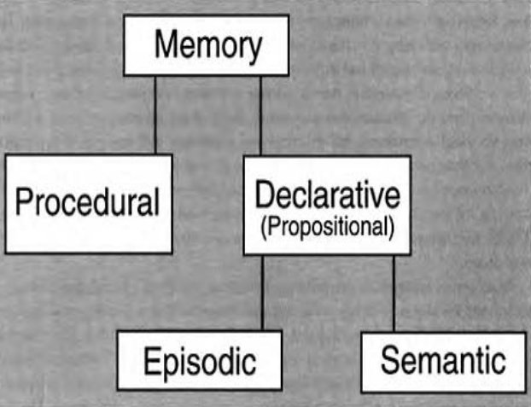

Slide 50
Mythologically Speaking...
The Unknown is represented by The Great Mother
The Known >>> The Great Father
The Explorer >>> The Archetypal Son

Slide 51
The Great Mother
The Great Mother—the unknown, as it manifests itself in experience—is the feminine deity who gives birth to and devours all. She is the unpredictable as it is encountered, and is therefore characterized, simultaneously, by extreme positive and extreme negative valence.

Slide 52
The Great Father
The Great Father is order, placed against chaos; civilization erected against nature, with nature’s aid. He is the benevolent force that protects individuals from catastrophic encounter with what is not yet understood; is the walls that surrounded the maturing Buddha and that encapsulated the Hebrew Eden. Conversely, however, the Great Father is the tyrant who forbids the emergence (or even the hypothetical existence) of anything new.

Slide 53
The Archetypal Son
The Archetypal Son is the child of order and chaos—culture and nature—and is therefore clearly their product. Paradoxically, however, as the deity who separates the earth (mother) from the sky (father), he is also the process that gives rise to his parents. This paradoxical situation arises because the existence of defined order and the unexplored territory defined in opposition to that order can come into being only in the
light of consciousness, which is the faculty that knows (and does not know). The Archetypal Son, like his parents, has a positive aspect and a negative aspect. The positive aspect continually reconstructs defined territory as a consequence of the “assimilation” of the unknown [as a consequence of “incestuous” (that is, “sexual”—read creative) union with the Great Mother]. The negative aspect rejects or destroys anything it does not or will not understand.

Slide 54
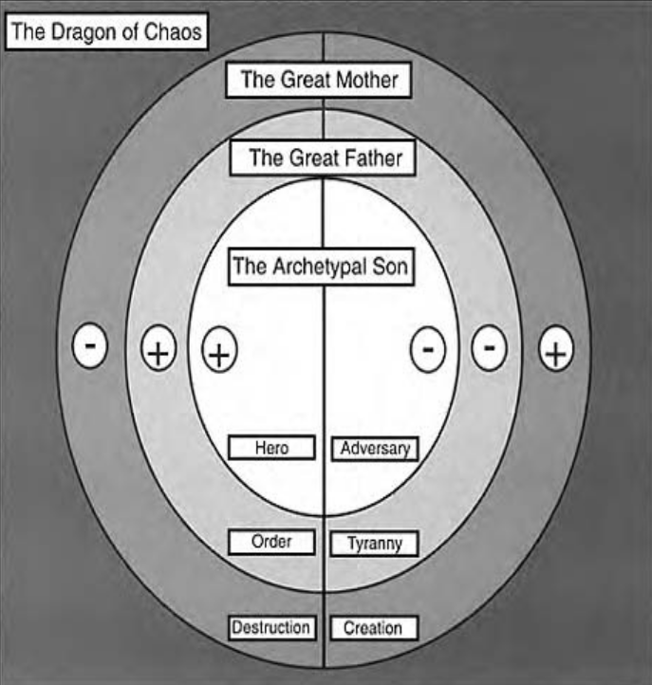

Slide 55
Chapter 3: Apprenticeship and Enculturation

Slide 56
Apprenticeship: Adoption of a Shared Map
Subjugation to lawful authority might more reasonably be considered in light of the metaphor of the apprenticeship.
Childhood dependency must be replaced by group membership, prior to the development of full maturity.
Such membership provides society with another individual to utilize as a “tool,” and provides the maturing but still vulnerable individual with necessary protection (with a group-fostered “identity”). The capacity to abide by social rules, regardless of the specifics of the discipline, can therefore be regarded as a necessary transitional stage in the movement from childhood to adulthood.
Discipline should therefore be regarded as a skill that may be developed through adherence to strict ritual, or by immersion within a strict belief system or hierarchy of values. Once such discipline has been attained, it may escape the bounds of its developmental precursor. It is in this manner that true freedom is attained. It is at this level of analysis that all genuine religious and cultural traditions and dogmas are equivalent, regardless of content: they are all masters whose service may culminate in the development of self-mastery, and consequent transcendence of tradition and dogma.
Apprenticeship is necessary, but should not on that account be glamorized. Dogmatic systems make harsh and unreasonable masters. Systems of belief and moral action—and those people who are identified with them—are concerned above all with self-maintenance and preservation of predictability and order. The (necessarily) conservative tendencies of great systems makes them tyrannical, and more than willing to crush the spirit of those they “serve.”
Apprenticeship is a precursor to freedom, however, and nothing necessary and worthwhile is without danger.
Adoption of this analytic standpoint allows for a certain moral relativism, conjoined with an absolutist higher-order morality. The particulars of a disciplinary system may be somewhat unimportant. The fact that adherence to such a system is necessary, however, cannot be disregarded.

